Slide 1

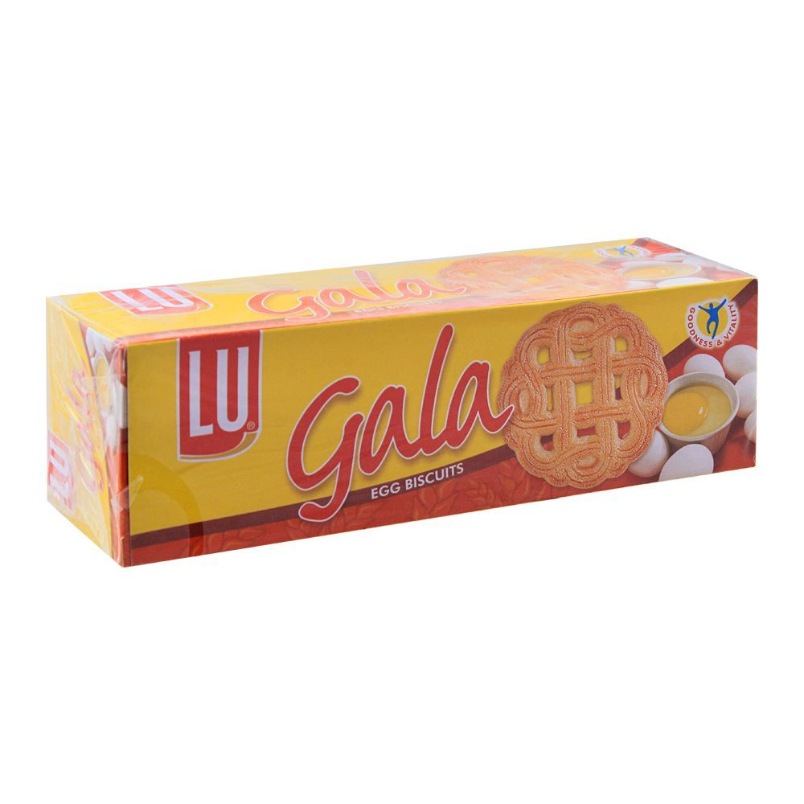

Presented by:-
Abdul Rehman Shoukat
Muhammad Usman
Mirza Kahsif
Jehanzeb Shehzad
Zain Khan

Slide 2
Marketing Management Orientation
Production Concept:
Gala biscuit is a product that can be classified as a convenience product as it is readily available and also priced low.
Product Concept:
The major quality and features, as the company states, lies within its wonderful aroma and distinct artistic design. No product improvement in recent years.
Selling concept:
It has a widespread distribution and is mass promoted by LU through TVC’s and other promotional efforts.

Slide 3
Marketing Management Orientation (Cont.)
Marketing Concept:
Gala aims to satisfy customers who desire a biscuit to serve guests. It is targeted towards buyers generally in the SEC B and C who can't buy traditional bakery biscuits and for individuals who want egg flavoured biscuits.
Social Marketing Concept:
The company aims to greater brand building while simultaneously focusing on the needs of the society and the environment by developing infrastructure, education, healthcare, water and sanitation and social welfare programmes.
Continuously upgrading processes, systems, products and services by creating value for local communities.
Helping culture and society flourish, by supporting charities, providing scholarships and by donating for humanitarian reasons.

Slide 4
Continental Biscuits
Plain & Sweet
Plain & Savory
Sandwich
Other

Slide 5
Plain & Sweet
Candi
Gala
Tiger
Snack Pack
Rs. 25
Family Pack
Rs. 50
Ticky Pack
Rs. 5
Snack Pack
Rs.25
Family Pack
Rs. 50
Ticky Pack
Rs. 5
Bar Pack
Rs. 10
Ticky Pack
Rs. 5
Bar Pack
Rs. 10

Slide 6
Brand Naming Strategy
Two brand naming strategy
House of Brands strategy applies the core strengths of the parent company to a wide variety by using one or more than one standalone brands
Example P&G Sub Brands(Gillette, Head & Shoulders and Tide)
Branded House strategy: all sub brands are linked with the main brand
Example Google (Google Drive, Gmail and Google Docs)

Slide 7
Brand Naming Strategy
Continental Biscuit uses House of Brands for its 9 Brands which are
TUC
OREO
PRINCE
GALA
TIGER
ZEERA PLUS
CANDI
MILCOLU
WHEATABLE

Slide 8
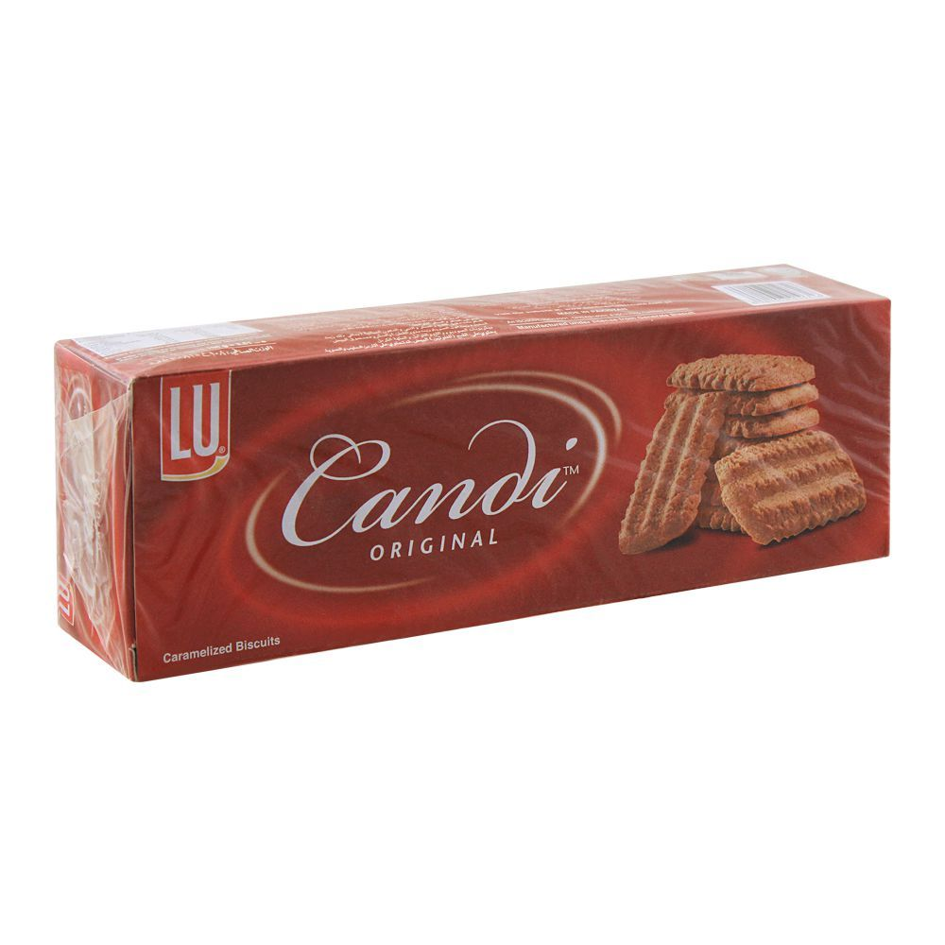
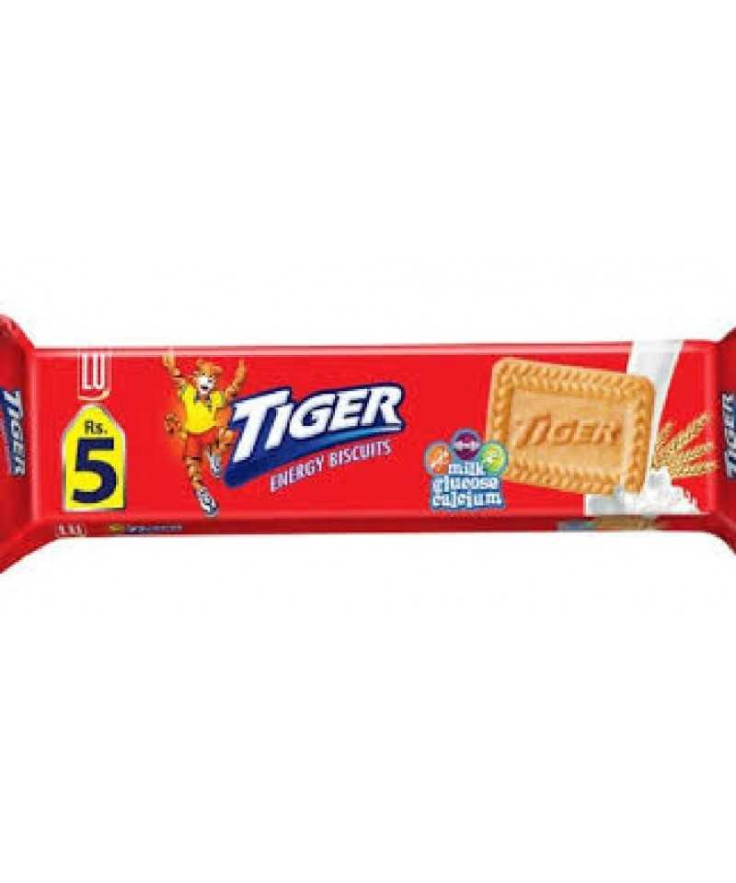
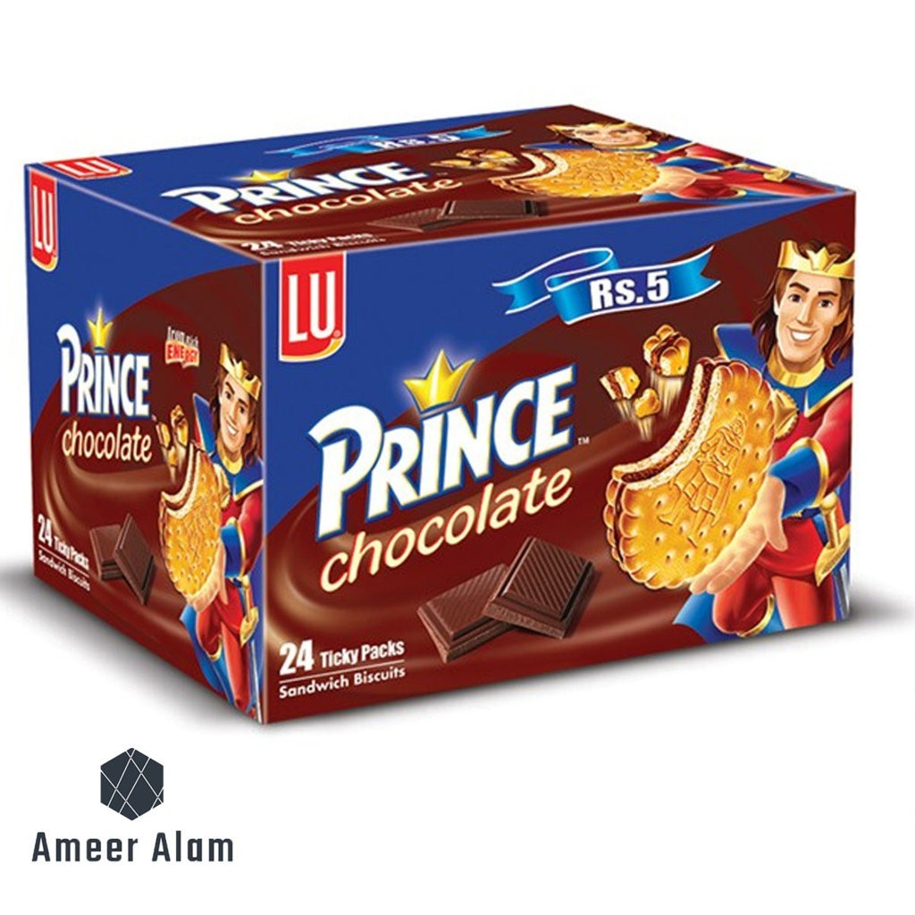
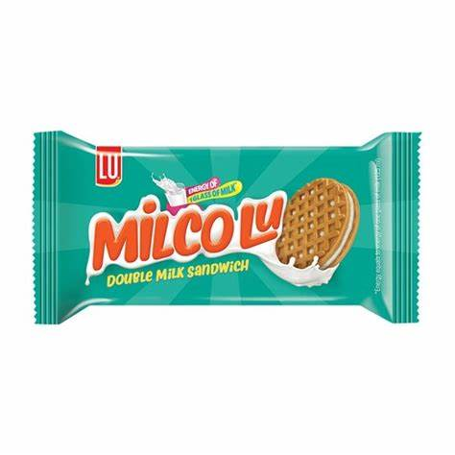
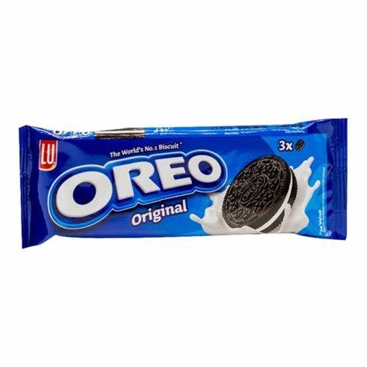
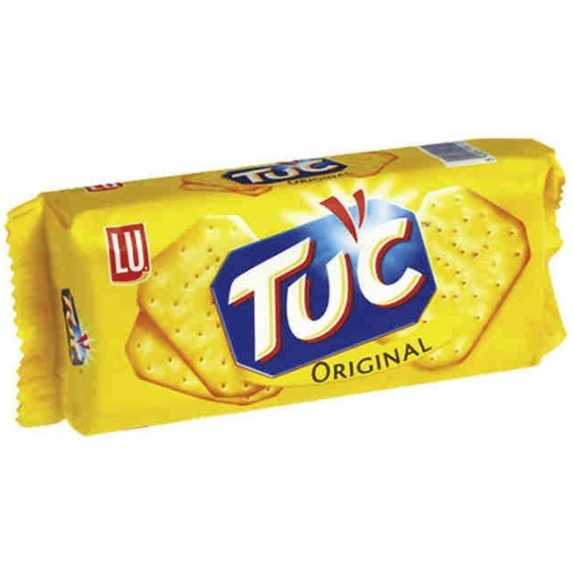
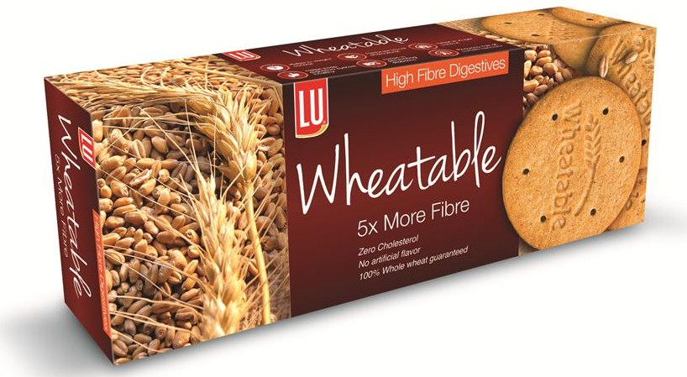
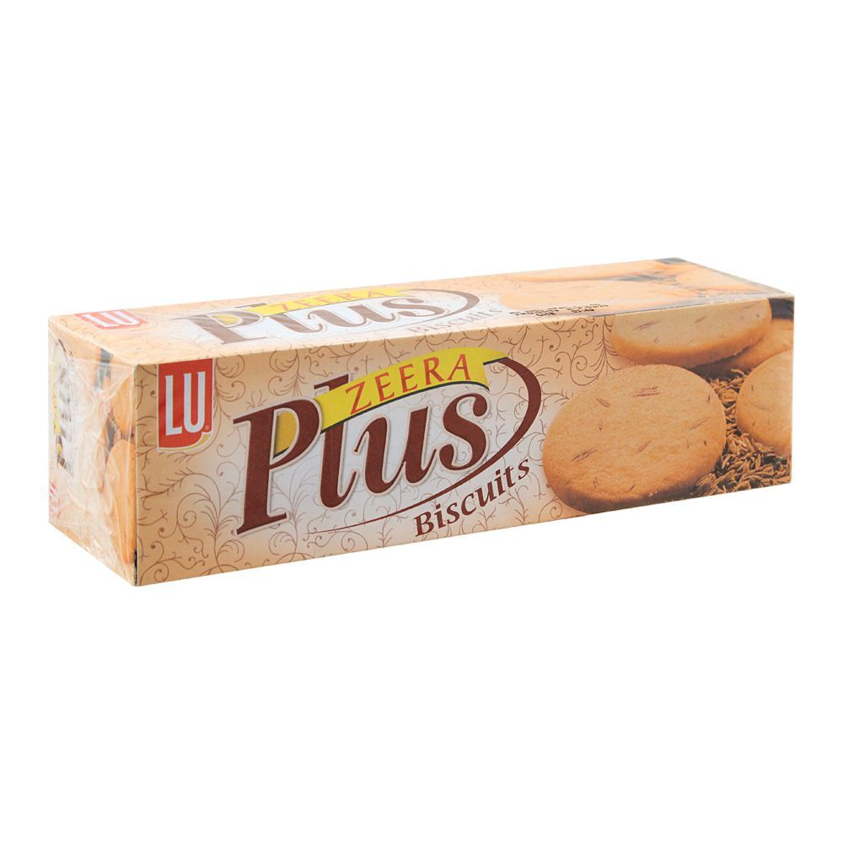
House of Brands

Slide 9
Brand Naming Strategy
Continental Biscuit uses Branded House for 1 Brand which is
Bakeri Range
Nan Khatai
Coconut Cookies
Butter Cookies
Bistiks

Slide 10
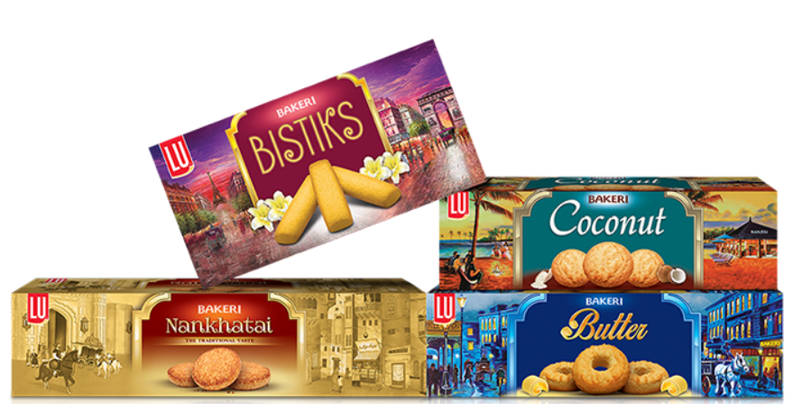
Branded House

Slide 11
Brand Naming Strategy
We choose GALA from the Plain & Sweet category
GALA has a House of Brands Strategy used
Distinct from other brands
Stands-alone as a (Natural Goodness of milk and egg)
For festivity and celebrations
100 Percent registered and manufactured in Pakistan

Slide 12
Target Market
Demographically Gala is Targeted towards Grown-ups, particularly those who enjoy drinking Tea.
  It is usually a side snack along with tea.
It is targeted towards whole of Pakistan as all provinces culture is represented in the advertisement.
  Also the main phrase “MERAY DES KA BISCUIT GALA”
Socio-Economic Classification (SEC) targeted is SEC B and C.
  Particularly individuals who receive middle or lower pay
  It is also preferred by students of Colleges and Universities .
Notes:
SEC A prefers NAN KHATAI from the bakery range
New Ad
https://www.youtube.com/watch?v=67cgfijQ-n8
Old Ad
https://www.youtube.com/watch?v=QoSxprCB4dA

Slide 13
Quality
Contains the nutrition of Milk and Eggs
  It gives a distinct aroma
Is tough and doesn’t break when dipped in tea.
Has an distinct symmetric design which is glazed.

Slide 14
Emotional Aspect
The older Advertisement appeals to emotion of family being together on a trip and enjoying.
The phrase “Zindagi ka Lutf Dobala” urges that the biscuit adds taste to life.
It is being enjoyed in leisure time and specifically the SKU (Stock Keeping Unit) is a large box which can be shared with family.

Slide 15
Original TVC
Aired in 2003
Stressed the idea of spending quality time with family
Implied the biscuits were full of nutrition and were to be enjoyed with the entire family
SKUS were mainly family packs

Slide 16
New TVC
The target market continues to be middle aged men and women
They added culture to the advert, as we can see Pakistani women dancing in traditional clothes
We also see a man with a Sindhi cap in the advert
The brand previously promised the nutrition of eggs and milk, but now they have added wheat as well
Their tagline has changed to “Mere des ka biscuit Gala” so they are really going for the “National biscuit” approach

Slide 17
Competitor: Similarities and differences
Sooper biscuit is Gala’s primary competitor
Both brands make milk and egg biscuits, so the ingredients are more or less the same
Gala promises to provide nutrition and promises to be the traditional biscuit of Pakistan
Sooper heavily uses culture in its ads, and promises to be the leading brand in biscuits
“Sab se Aagey, sab se oopar” reflects Sooper’s aim
“Poore des ka biscuit gala” reflects Gala’s

Slide 18
THANK YOU!

